Slide 1



Movie Recommendation
SYSTEM
Supervised by : Dr. Zaher Merhi
Committee Members:
Dr. Ali Bazzi & Dr. Mohammad Raad
Submitted by:
Nermine Obeid 91730236
Nareg Artinian 61630133
9/6/2022
1

Slide 2





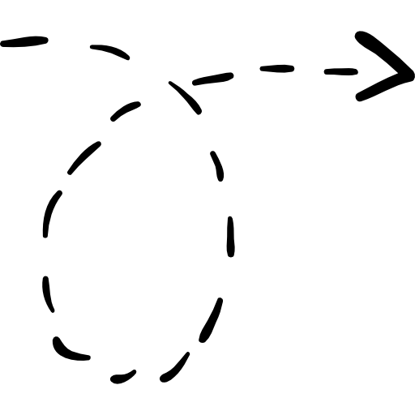


Outline
Outline
Project & General Overview
Dataset Usage
System Flowchart
Recommender System Flowchart & Algorithm used
Conclusion
Future Work
2
2

Slide 3



Build an online Movie Recommender System which is based on the analysis of users' ratings history to several movies and their interests.
Project Overview

Slide 4



Watch < 10 Movies
General view
Arbitrary Movies
Add new movie
Get list of movies
Watch > 10 Movies
Add MovieLens dataset
Recommended Movies

Slide 5
Dataset Usage
Dataset Usage
We have used MovieLens Dataset by GroupLens.
This data set consists of:
100,000 ratings (1-5) from 785 users on 10243 movies.
Each user has rated at least 20 movies.
Since we have developed a prototype of hybrid recommendation system. We have also scraped the content-based data from TMDB for the movies we already had for collaborative filtering purpose in the MovieLens dataset.

Slide 6
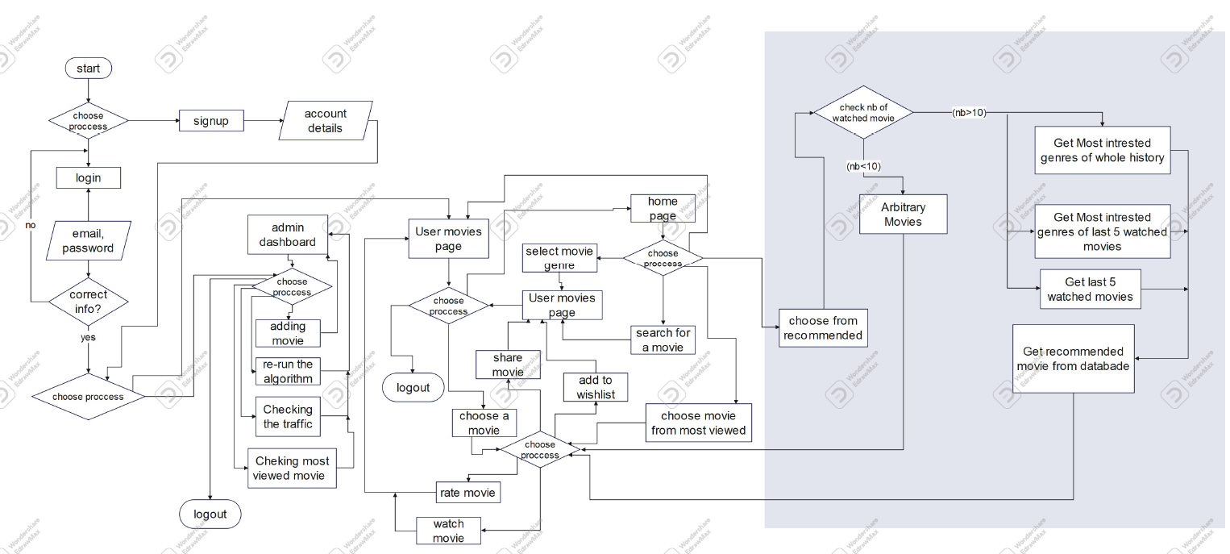
System Flowchart
System Flowchart

Slide 7
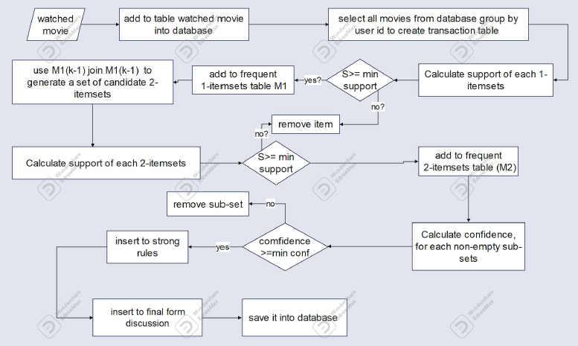
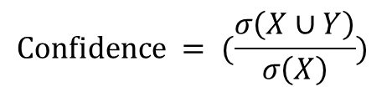
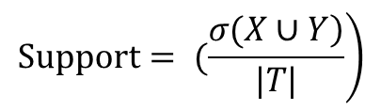
Recommender System Flowchart
Recommender System Flowchart
$$\left.Support= (\frac{\left.σ(X∪Y\right)}{|T|}\right)$$
$$Confidence = (\frac{σ\left(X∪Y\right)}{σ\left(X\right)})$$

Slide 8
Recommendation System Algorithm
Recommendation System Algorithm
Content Based: The recommendation system recommends other movies which are similar to that selected movie.
f(movie) {movies}
Collaborative Filtering: The recommendation system recommends movies which are rated highly by the similar users.
Almost all existing commercial recommenders use this approach (e.g. Amazon, Facebook, Linkedln).
f(movies, user) {movies}

Slide 9
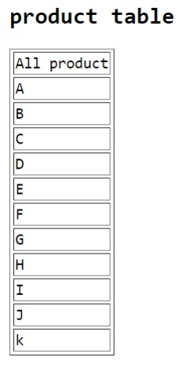
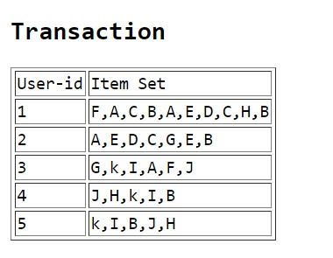
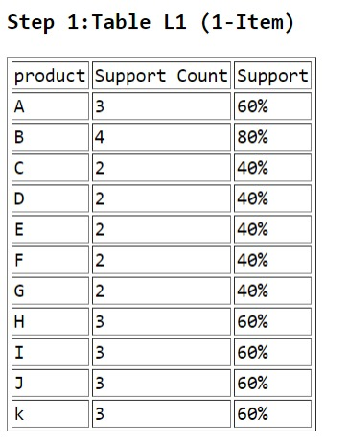
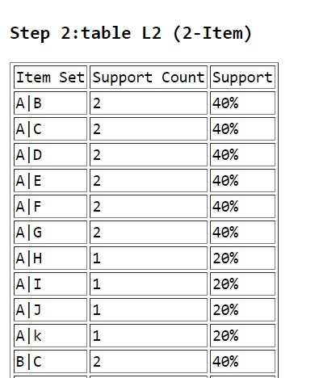
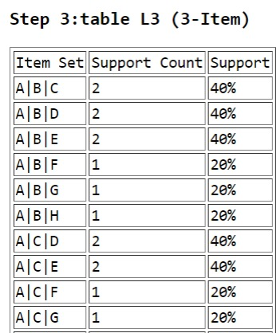
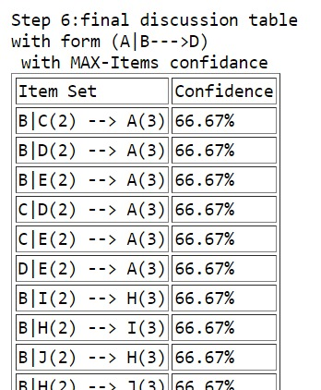
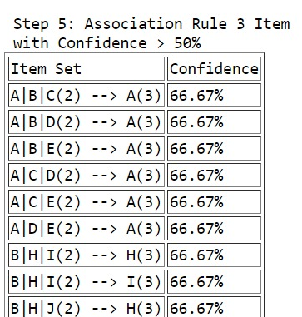
Association Rule Algorithm
Association Rule Algorithm
3.Calculate the Support
of each product
4.Calculate support
of 2-items
If S > min S
If S > min S
2.Group all orders using user-id
1.Select all products from database
Join table L3 with L1
create subset (A|B|C→A)
Calculate confidence of subsets
If confidence > min confidence

Slide 10


Apache:
to create the website.
included codes (HTML, CSS, JavaScript, PHP).
Technical Requirements
WAMP Control Panel ::
to execute the code and to interact with database

Slide 11



Implementation tools
Implementation tools

Slide 12
Conclusion
Conclusion
Movie recommendation systems provide a mechanism to assist users in classifying users with similar interests.
As powerful data filtering tools, recommendation systems use algorithms and data analysis techniques to recommend the most relevant product/items to a particular user
Our project is Content-based and Collaborative Filtering Recommender System which depends on the user's preferences and predicting the pursuits of a person by the means of figuring out possibilities and records from many users respectively.
We integrated successfully a recommended system with high accuracy to show the customers the products according to their interests.
12
12

Slide 13
Future Work
Future Work
Ask user to enter more details such as Gender, Age to recommend movies based on these criteria.
Increase the visibility of our website when people search on Google using SEO (Search Engine Optimization)
Grow our business by putting organic or paid ads using SEM (Search Engine Marketing)
Implement an Android and iOS application of this system
Scraping data from Netflix by api to automatically list the new movies, its images and its information
13
13

Slide 14


Thank y u!

